Slide 1

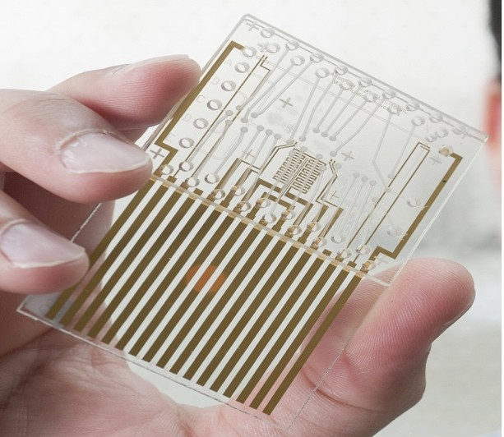
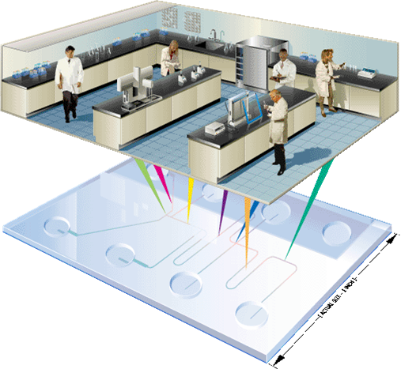
Converging Artificial Intelligence (AI) and Capillary Microfluidics simulation in Lab-on-a-chip
Academic Supervisor:
Dr. A. Tarokh, Lakehead University
Partner organization:
Dr. M. Saboori, Hudson International Consultant and Investment
Intern:
Dr. A. Amiri Delouei, Lakehead University

Slide 2
Introduction
2
Dear Dr. Saboori,
I would like to inform you that I have successfully completed Stage 1 (literature review) and Stage 2 (CFD analysis) of the project outlined in the Mitacs proposal and will now continue with the next stage.
In the next slides, I will also present results from studies that are published or ready to be published, including the following titles:
A Comprehensive Analysis of Capillary Penetration in Circular and Rectangular Microchannels
Capillary Transport Behavior in Elliptical Microchannels Based on Theoretical Modeling
Direct Numerical Simulation of Capillary Microfluids: Lattice Boltzmann Method

Slide 3
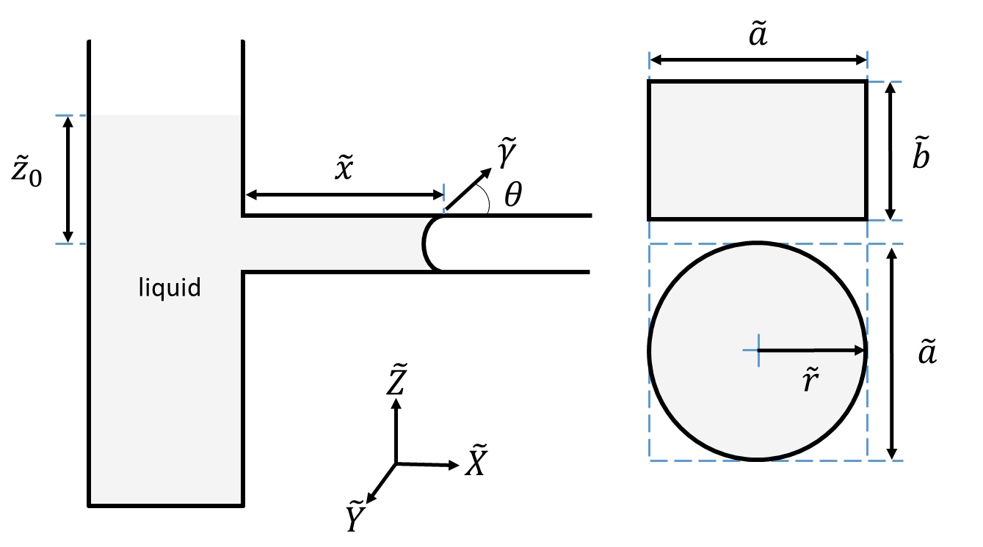
A Comprehensive Analysis of Capillary Penetration in Circular and Rectangular Microchannels
3
Introduction:
This research presents an analytical examination of the capillary penetration phenomenon. In this research, a laminar and incompressible flow in circular and rectangular ducts is considered.

Slide 4
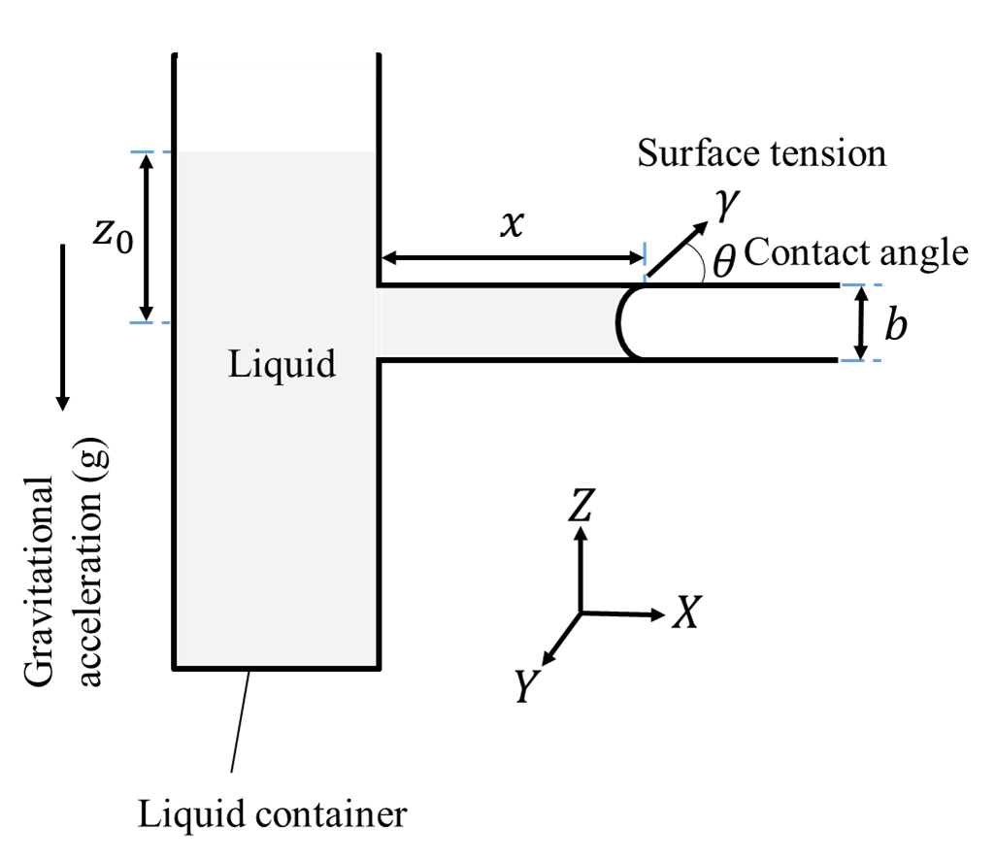

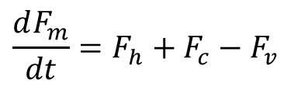



A Comprehensive Analysis of Capillary Penetration in Circular and Rectangular Microchannels
4
All Forces:
All Forces
the momentum of the liquid column
hydrostatic pressure
capillary
viscous (retarding)
The length of the column of liquid
$$F_{m}$$
$$F_{h}$$
$$F_{c}$$
$$F_{v}$$
The Motion equation:
$$\frac{dF_{m}}{dt}=F_{h}+F_{c}−F_{v}$$
Capillary Penetration in Microchannels.

Slide 5
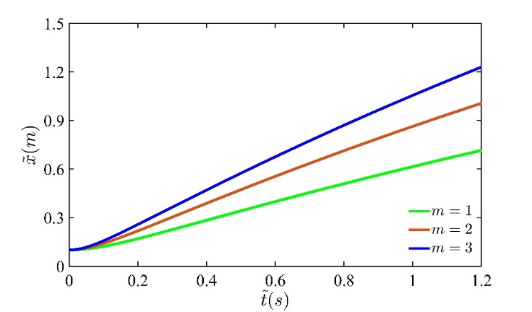
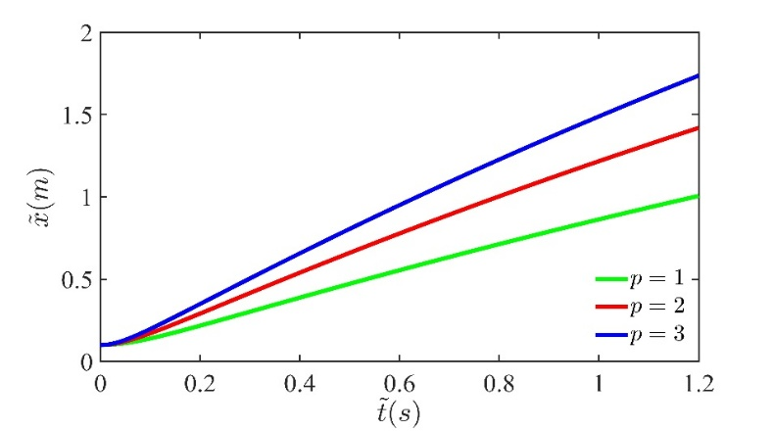
A Comprehensive Analysis of Capillary Penetration in Circular and Rectangular Microchannels
5
Results:
Variation of the column length versus time for different values of m in circular (n = 1) cross-sections at
Variation of the column length versus time for different values of p in rectangular (q = 1) cross-sections at

Slide 6
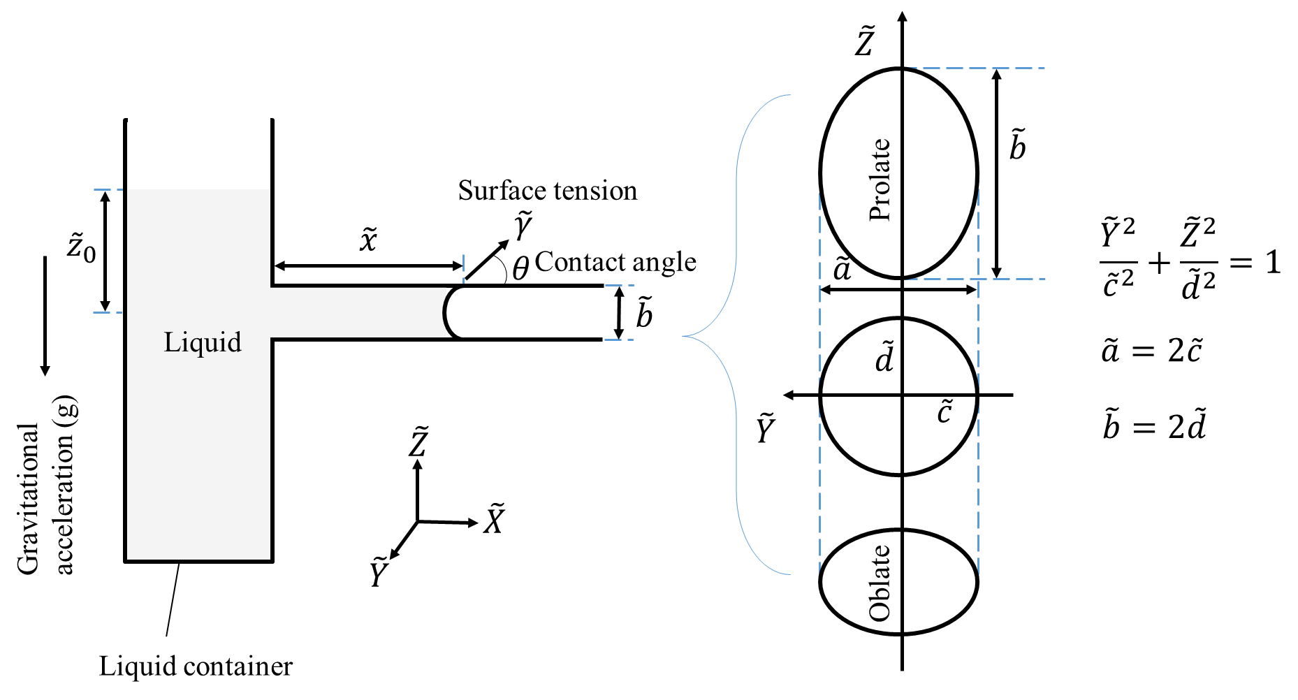
Capillary Transport Behavior in Elliptical Microchannels Based on Theoretical Modeling
6
Introduction: This research presents a comprehensive theoretical investigation into the capillary penetration phenomenon within elliptical microchannels. This study develops a detailed mathematical framework for analyzing the process by focusing on the governing equations, initial conditions, and solution methods within a two-dimensional context.

Slide 7

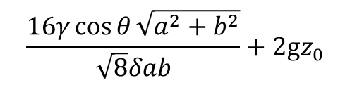
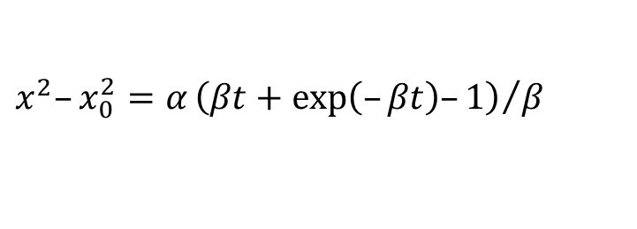
Capillary Transport Behavior in Elliptical Microchannels Based on Theoretical Modeling
7
Analytical solution:
After considering all the forces, the equation can be analytically solved by considering the initial conditions.
$$x^{2}–x_{0}^{2}=α{\left(βt+exp\left(–βt\right)–1\right)}/β$$
Viscous force
Capillary force
$$\frac{16μ\left(a^{2}+b^{2}\right)}{δa^{2}b^{2}}$$
$$\frac{16γ\cos{θ}\sqrt{a^{2}+b^{2}}}{\sqrt{8}δab}+2gz_{0}$$

Slide 8
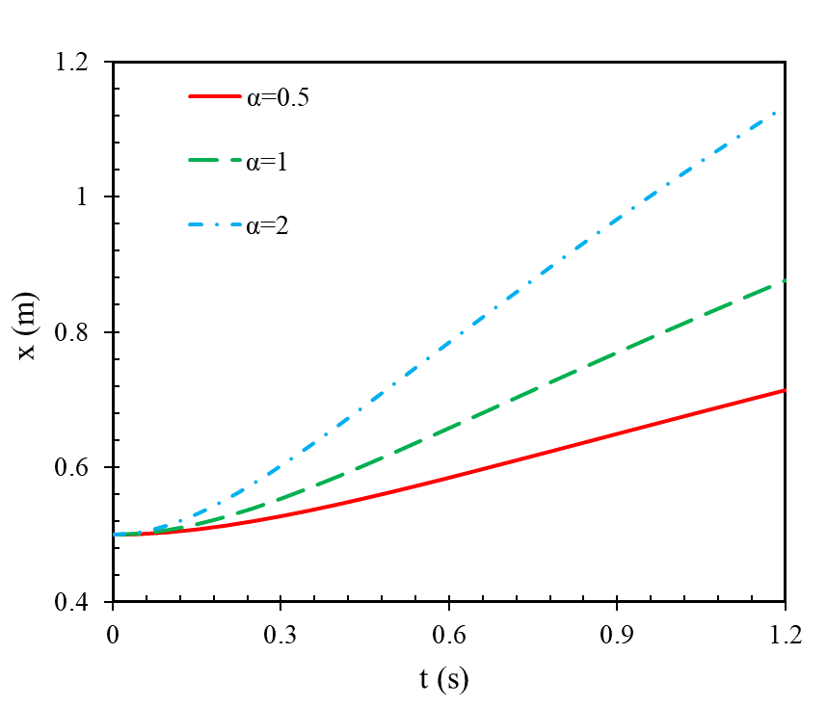
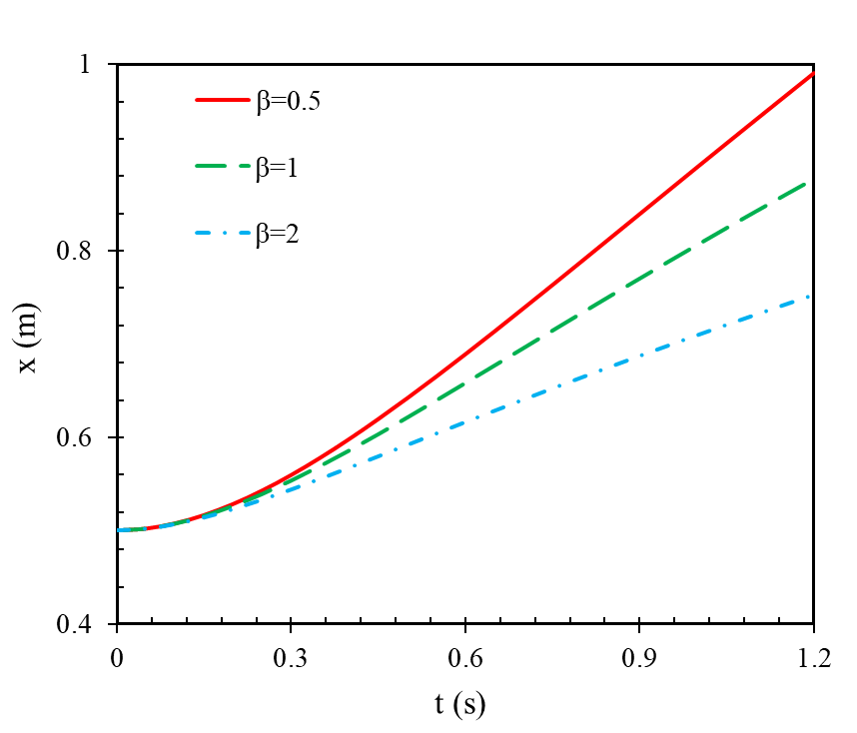
Capillary Transport Behavior in Elliptical Microchannels Based on Theoretical Modeling
8
The effect of capillary and viscous forces on x:
(a)
(b)
Variation of 𝑥 versus time for different value of (a) α, and (b) β.

Slide 9
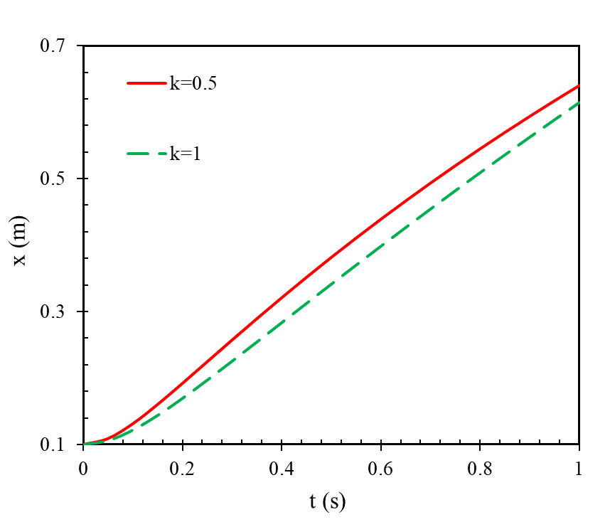
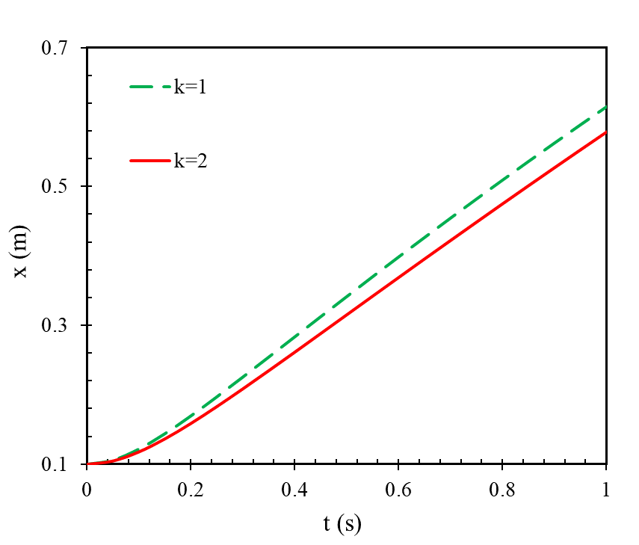
Capillary Transport Behavior in Elliptical Microchannels Based on Theoretical Modeling
9
The effect of aspect ratio (k = b/a) on x:
(a)
(b)
Variation of 𝑥 versus time for different shape at $x_{0}=0.1$ (a) oblate and circular shapes, and (b) circular and prolate shapes.

Slide 10
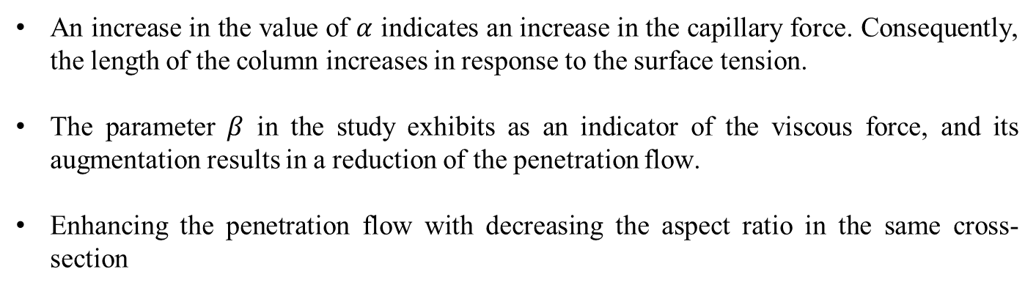
Capillary Transport Behavior in Elliptical Microchannels Based on Theoretical Modeling
10
All Findings:
An increase in the value of $α$ indicates an increase in the capillary force. Consequently, the length of the column increases in response to the surface tension.
The parameter $β$ in the study exhibits as an indicator of the viscous force, and its augmentation results in a reduction of the penetration flow.
Enhancing the penetration flow with decreasing the aspect ratio in the same cross-section
prolate
circular
oblate
Enhancing the penetration flow in the same cross-section

Slide 11
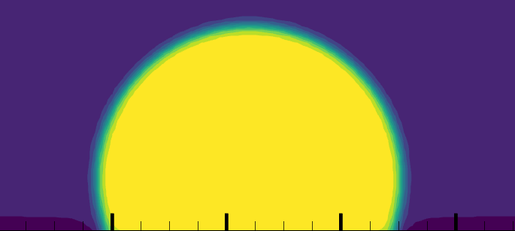
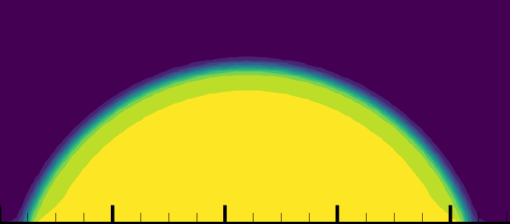
Direct Numerical Simulation of Capillary Microfluids:
Lattice Boltzmann Method
11
Introduction: This research employs the lattice Boltzmann method (LBM) to model the motion of a two-phase flow in a microchannel. The fluid flow in this system is primarily driven by surface tension. To validate the accuracy of the developed code, simulations of a droplet on both hydrophilic and hydrophobic surfaces are conducted, yielding successful results. These findings demonstrate the strong capability of the LBM in accurately simulating surface-tension driven flows in microfluidic systems.
Droplet on hydrophilic and hydrophobic surfaces

Slide 12
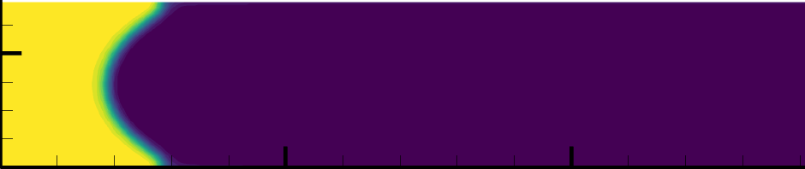
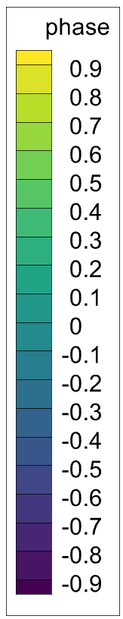
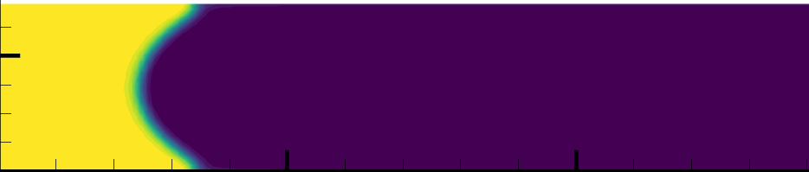
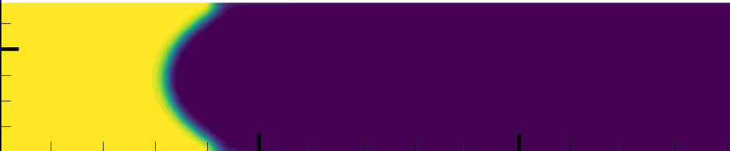
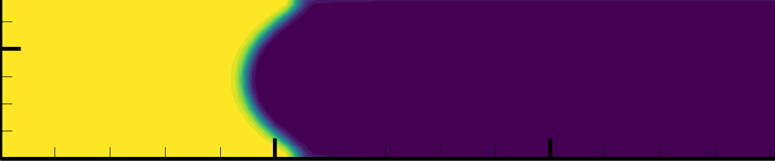
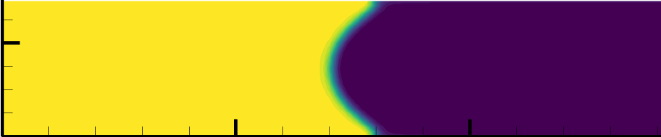
Direct Numerical Simulation of Capillary Microfluids:
Lattice Boltzmann Method
12
Results for two-phase flow interface in a microchannel:
The simulation results demonstrate the effectiveness of the lattice Boltzmann method (LBM) as an efficient approach for conducting Direct Numerical Simulation (DNS) of Capillary Microfluids.
Interface surface in different positions

